Slide 1


Slide 2

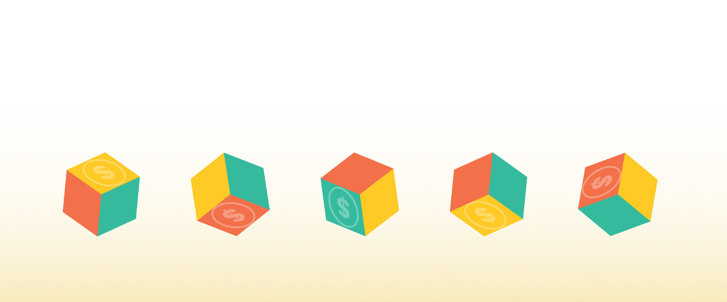
Meet Maker
Unlocking the power of the Blockchain to create economic empowerment.
Notes:
Maker is a decentralized autonomous organization that built the Dai Credit System.
Dai is the essential piece of the puzzle to unlock an empowered financial future

Slide 3
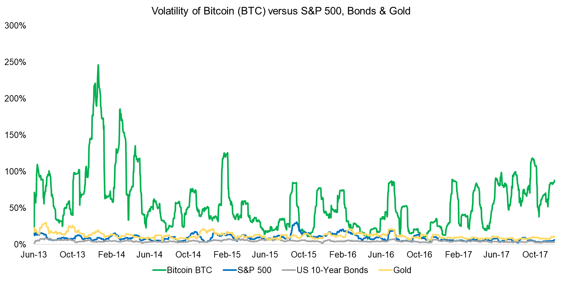
Why?
Businesses and individuals require a stable medium of exchange
Existing cryptocurrencies are too volatile to be a replacement for cash
Notes:
Maker is a decentralized autonomous organization that built the Dai Credit System.
Dai is the essential piece of the puzzle to unlock an empowered financial future

Slide 4
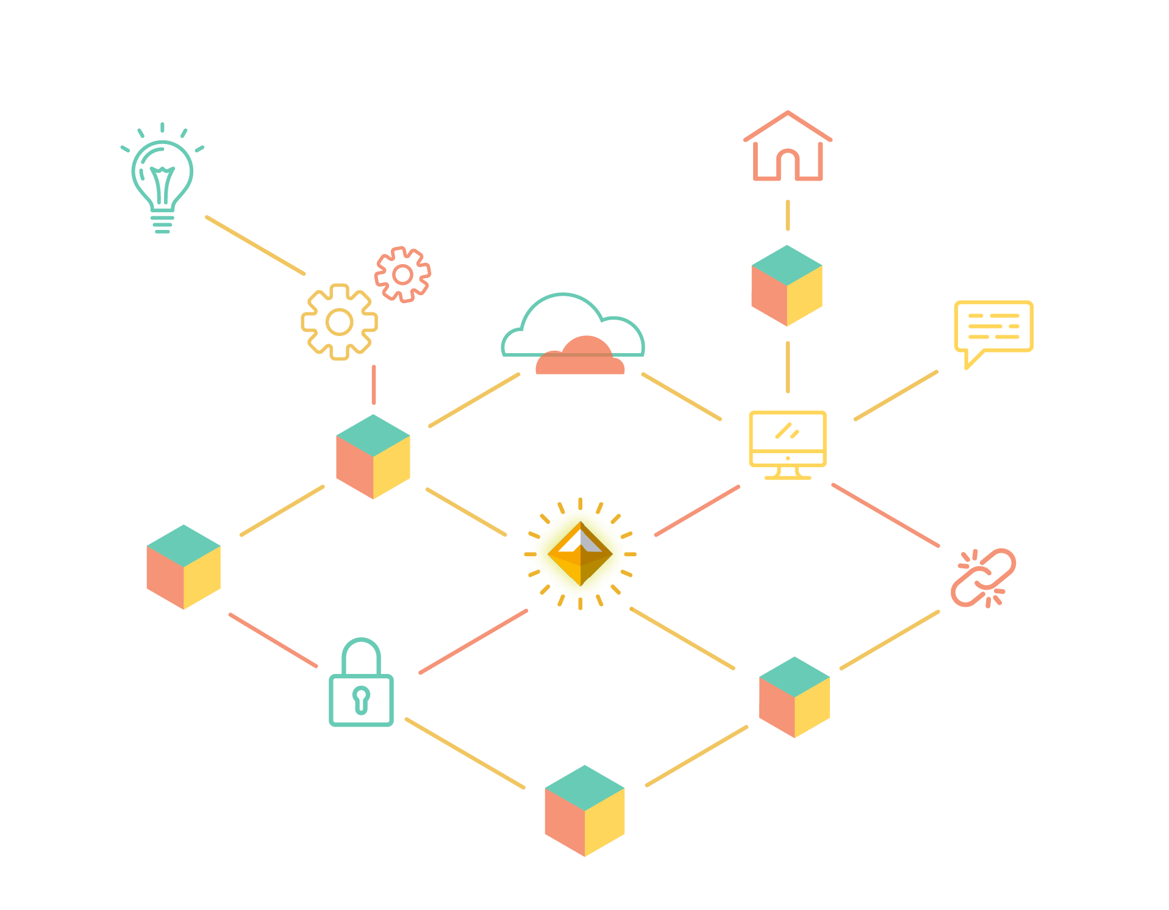
A stablecoin is needed for mainstream adoption of cryptocurrencies.
Notes:
The next phase of the financial revolution will be unlocked when a decentralized, safe, secure stablecoin has achieved scale in the marketplace.

Slide 5

But first...
Not all stablecoins are equal.
≠
≠
IOU
Seigniorage
Share
Notes:
Let’s take a quick look at the various forms of stable coin systems that are either planned or are in existence today:
Centralized:
IOU Model: (a token which is based on the principle of “when you give me fiat, then i give you a token which signifies that I owe you the redeemable value of that token”) Holders of the token need to trust a traditional, centralized organization or a legal agreement.
Decentralized & enabled by smart contracts:
Seigniorage shares model: Trust that the future value of the underlying bonds always increases, the economics incentives and structure are sound and that the smart contracts are secure.
Over-collateralized, Globally settleable Model: Trust the security of the smart contracts and the economic incentivizes and structure which ensure it’s stability.

Slide 6
Timeline
Sai (Alpha)
Dai (Beta)
Multi-Collateral Dai
December 2016
December 2017
Fall 2018

Slide 7
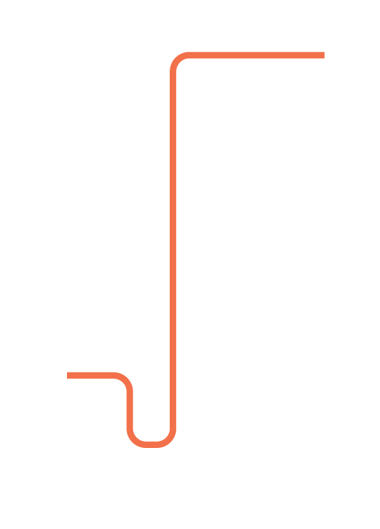
Why Maker
Dai stablecoin - Soft pegged to USD
Asset-backed hard currency
Permissionless credit system
$

Slide 8

Use case #1
Stability

Slide 9
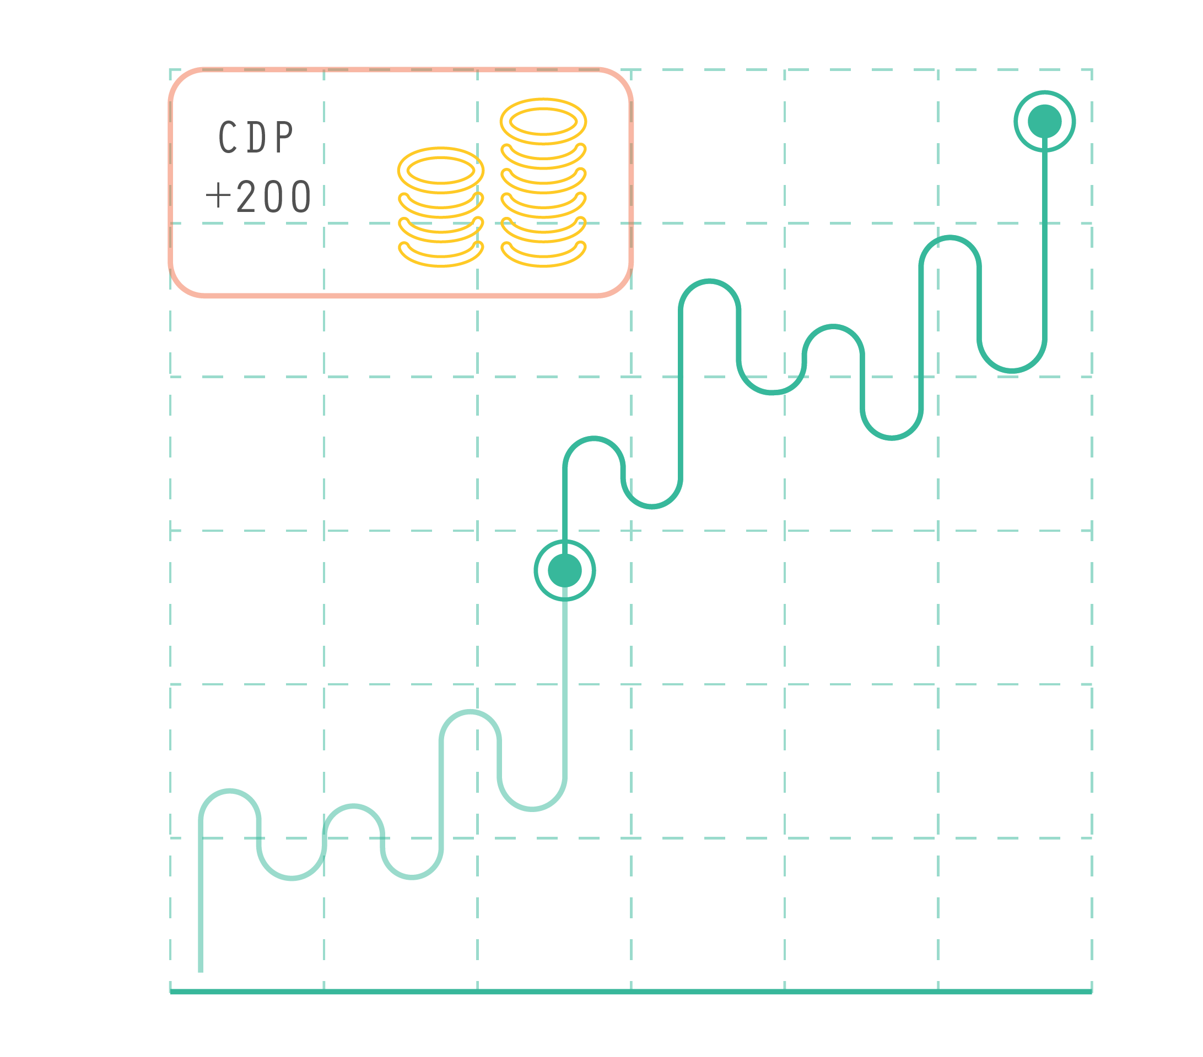
Collateralized Debt Position (CDP)
Notes:
The second and third reasons one would interact with the Dai Credit System is via what we call a Collateralized Debt Position, or CDP for short. Both of these use cases are speculative and are dependent on the creator having faith in the future value increase of the asset they are depositing into the CDP.

Slide 10



Use case #2
Accessible, asset backed loans

Slide 11

Use case #3
Low counterparty risk & margin trading

Slide 12
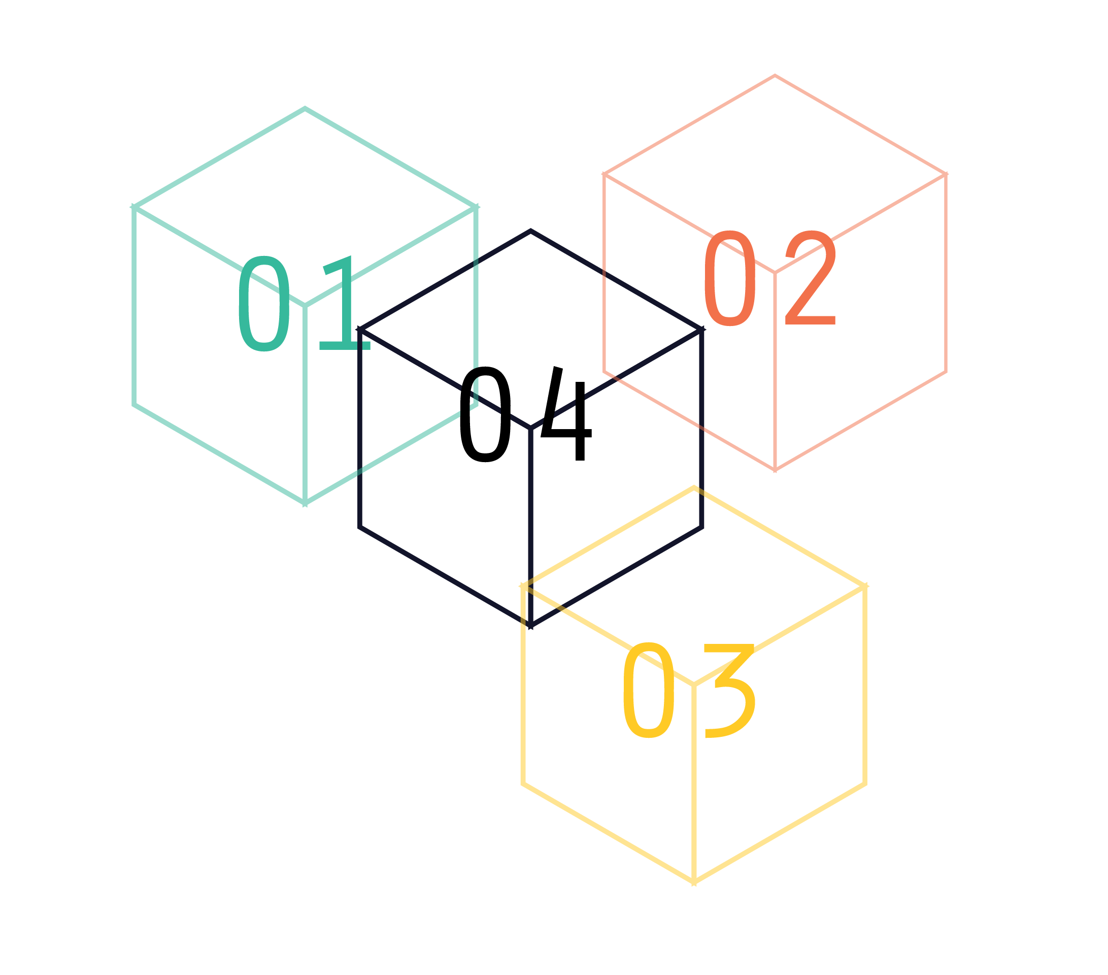
Properties of a durable stablecoin
Multi-collateral:
Resilience in the face of black swans.
Notes:
The current version of Dai in the wild is single collateral which means that if a black swan were to occur and the price of ETH was to drop instantaneously across all exchanges at once to 0, then Dai would fail. The multi collateral version of Dai is due to be released in June will be resilient even in the face of such an event because the collateral pool will be diversified with non-correlated assets. This means that even if one collateral type fails completely that Dai holders would still be made whole because all CDPs in which the Dai were created are all over-collateralized.

Slide 13
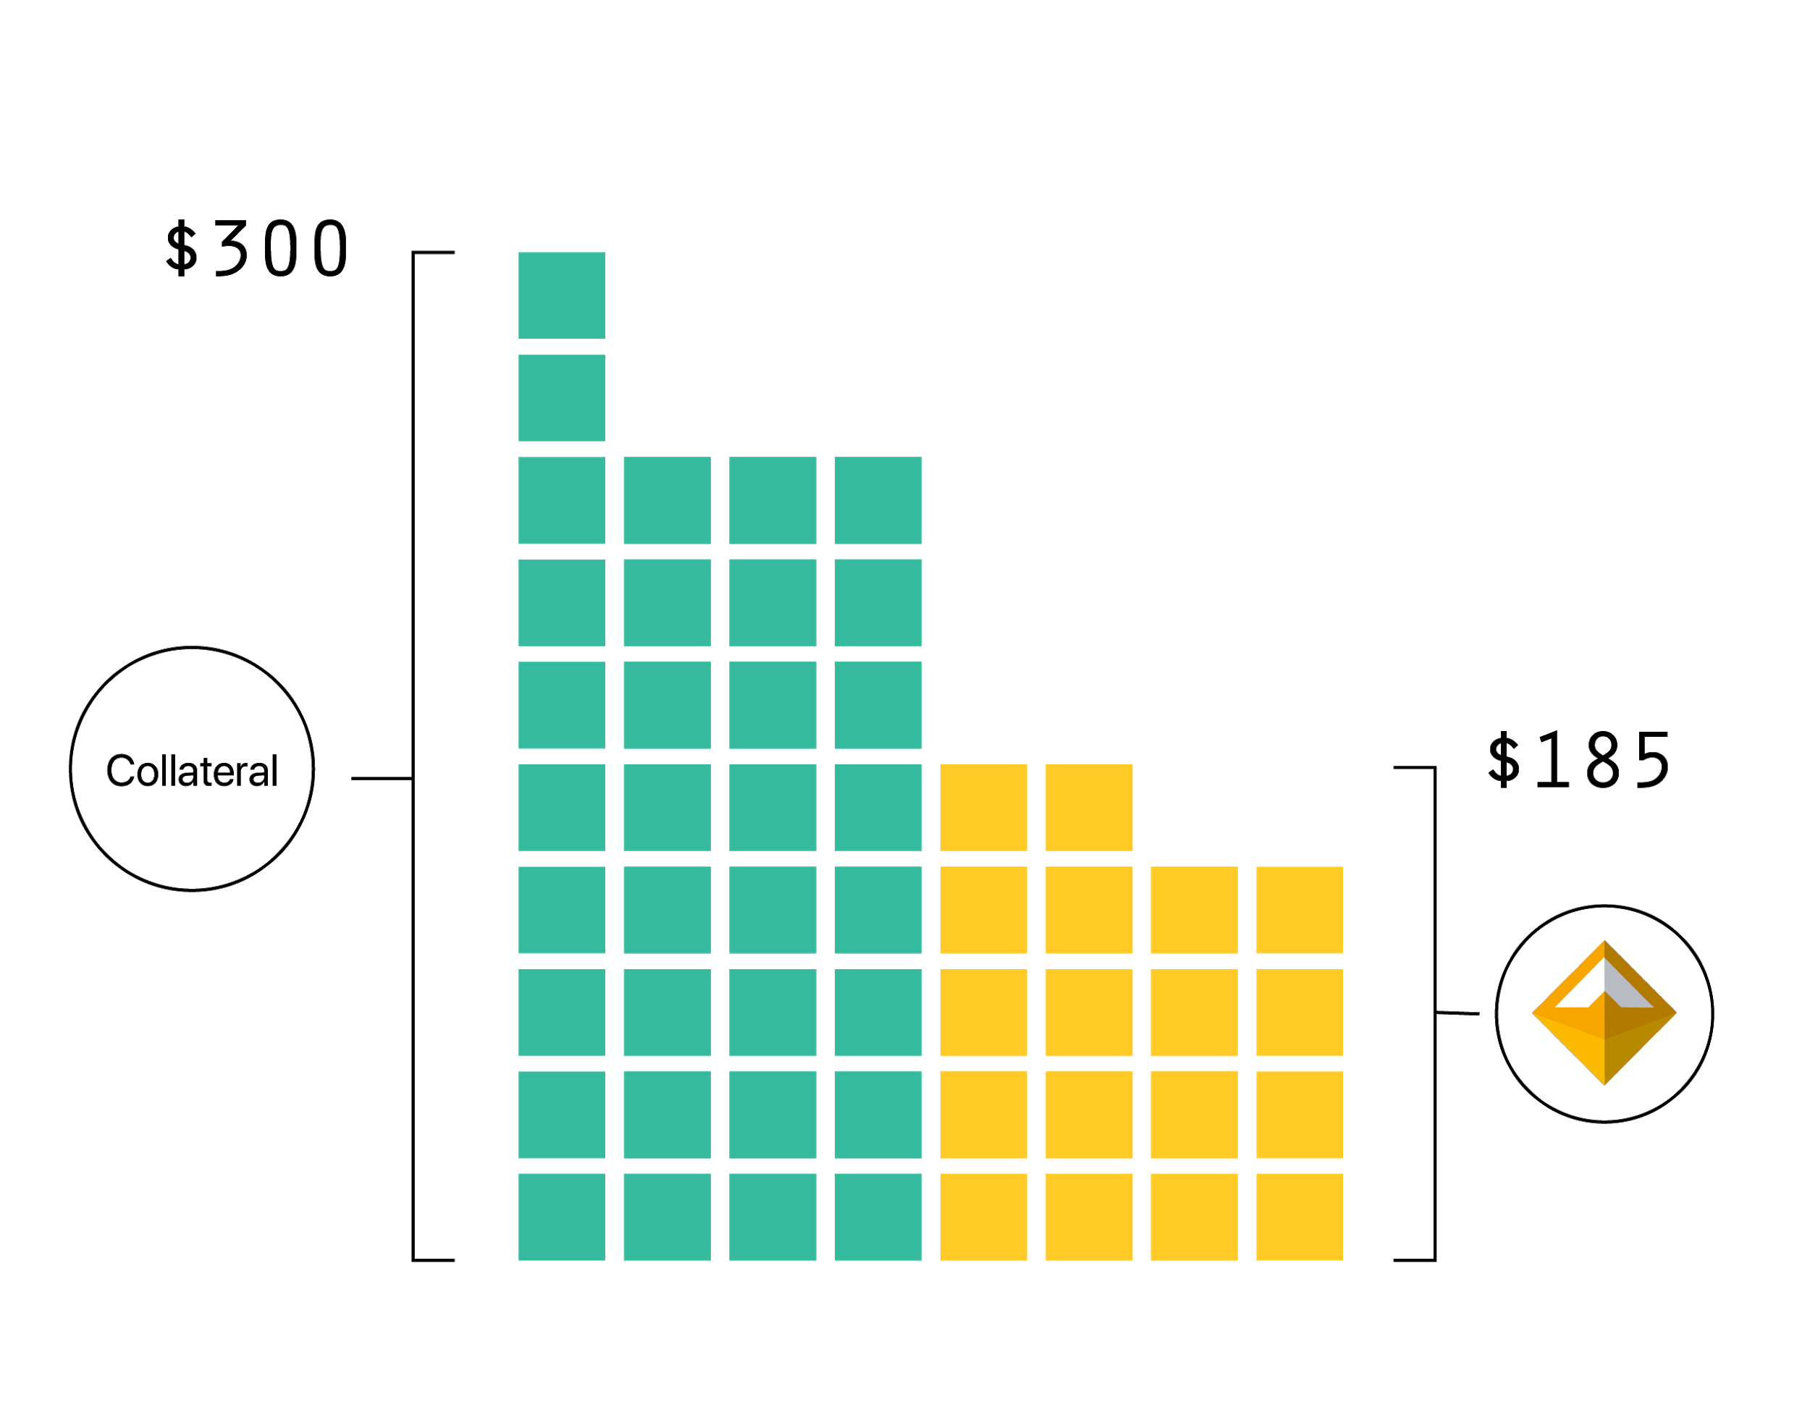
Properties of a durable stablecoin
Over collateralized:
Always a higher value of collateralized assets backing Dai than the Dai in circulation.
Notes:
Overcollateralization ensures that in event of a rapid decrease in asset price that a CDP can be liquidated with extra value to spare. This ensures that Dai holders can sleep well at night knowing that no matter what happens to the price of the asset backing their Dai that they can always receive equivalent value of the assets backing the Dai in circulation.
At the time of writing CDP’s were currently 370% over-collateralized.

Slide 14
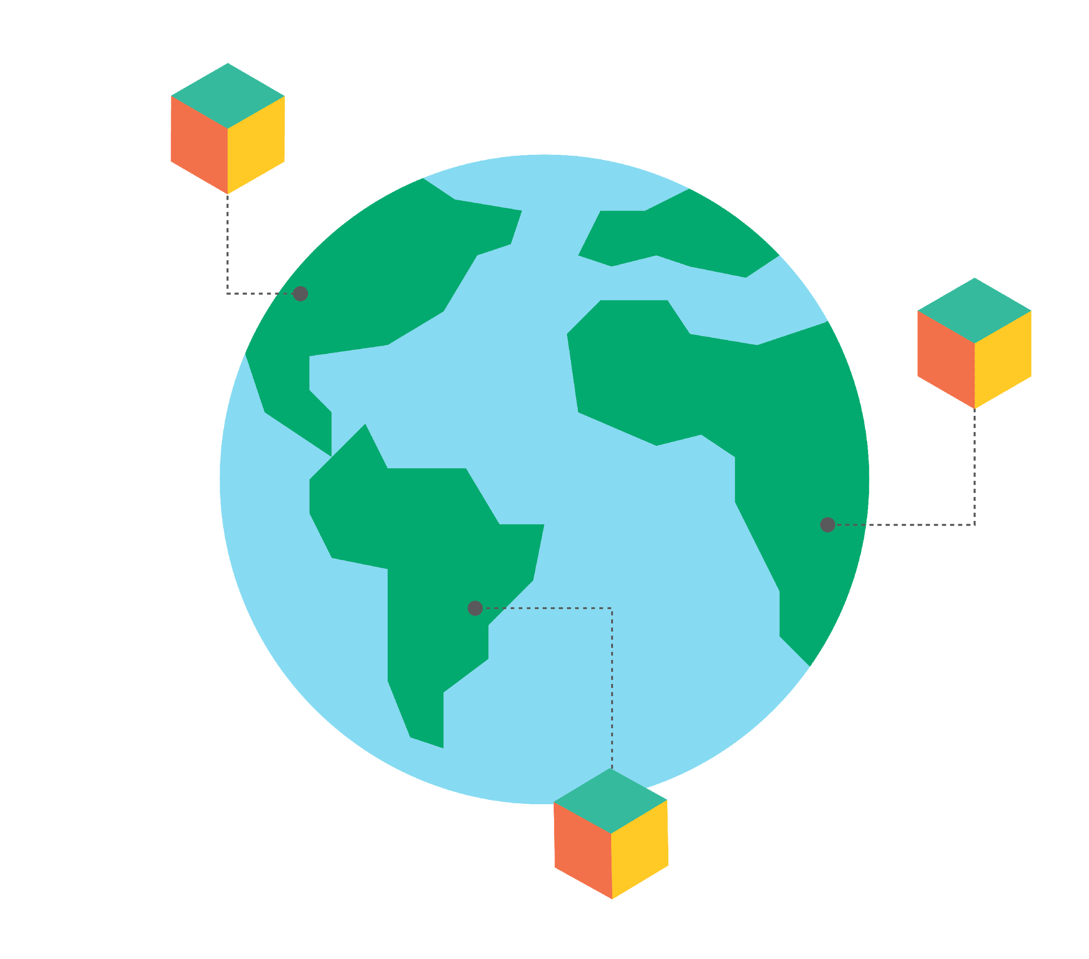
Properties of a durable stablecoin
Global settlement:
The ultimate peg enforcement mechanism. Supported by arbitrageurs banking on overcollateralization.
Notes:
The last method we use to ensure stability and security of the system is what we call global settlement.
At any point in time if the price of Dai strays too far away from the dollar... the system can be “globally settled”.
This means that the value of the assets which back each Dai can be made available to be redeemed by each Dai holder.
This THREAT ensures that a class of motivated actors called keepers can in good faith provide liquidity on either side of the peg and make a profit doing so as they know that if the price moves far enough away from the peg that the system can and will be settled.

Slide 15
Properties of a durable stablecoin
Multi-collateral:
Resilience in the face of black swans.
Over collateralized:
Always the equivalent of more money backing Dai than the Dai in circulation.
Global settlement:
The ultimate peg enforcement mechanism. Supported by arbitrageurs banking on overcollateralization.
Notes:
To summarize, these are the methods that ensure the security and stability of multi collateral Dai:
Diversifed, uncorrelated collateral pool which is thus reslient in the face of black swans
Over collateralization and the threat of global settlement at any time ensure the stability of Dai.
Arbitrageurs provide liquidity at the peg because they know that the system can be shut down at any time and have exactly $1 worth of collateral returned to them.
The old instance of Dai is then rendered invalid and the holder is prompted to migrate to the new instance by redeeming the old instance

Slide 16
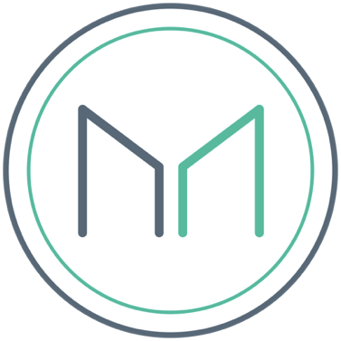
MKR - Administrative token:
Fuel for the credit system
Decentralized Regulator Community
A high risk, high reward volatile asset
Notes:
MKR is used for voting in new collateral types and it is also used to vote on the risk parameters associated with these collateral types.
It is also a necessary ingredient to close a CDP and is thus the fuel for the Dai Credit System

